Slide 1
Representing geometric sequences graphically
Non-linear relationships

Slide 2
how to use Oak lessons

Slide 3
I can represent geometric sequences graphically and appreciate the common structure.

Slide 4
A geometric sequence is a sequence with a constant multiplicative relationship between successive terms.
A common ratio is a key feature of a geometric sequence. The constant multiplier between successive terms is called the common ratio.

Slide 5

Representing geometric sequences graphically
Graphing a common ratio greater than 1
Graphing a common ratio less than 1

Slide 6
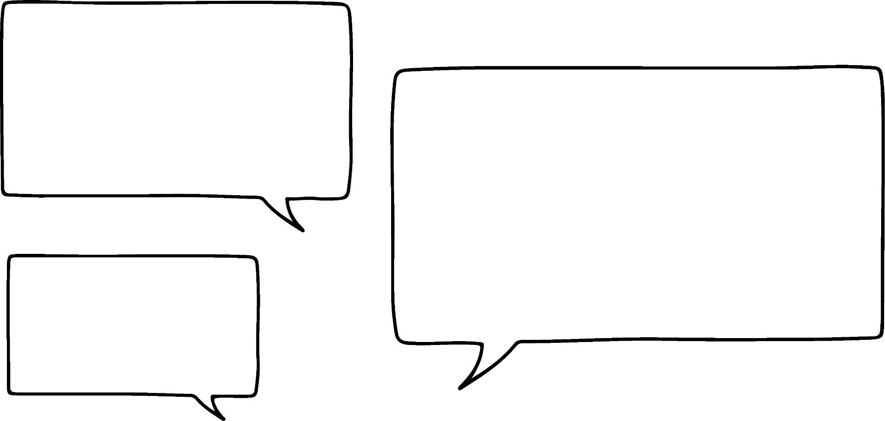
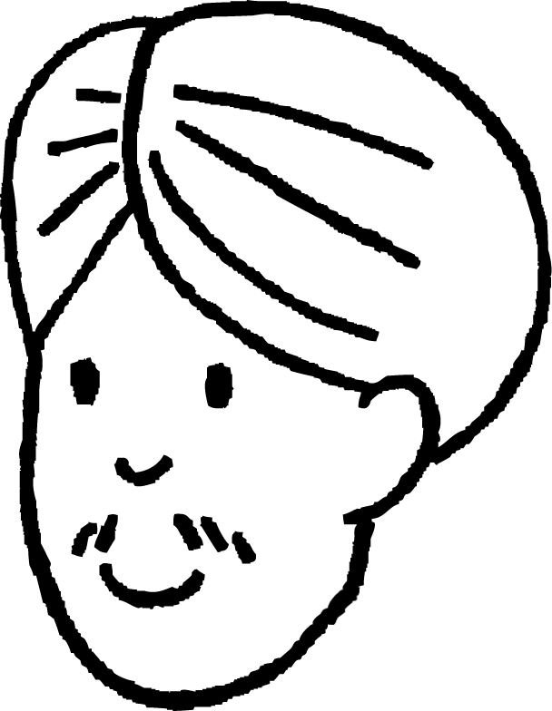

Graphing a common ratio greater than 1
Andeep and Sam are making models of sequences.
My sequence is arithmetic. It starts on 1 and has a term-to-term rule of +2
My sequence is geometric. It starts on 1 and has a term-to-term rule of ×2

Slide 7
Graphing a common ratio greater than 1
Andeep and Sam are making models of sequences.
My sequence is arithmetic. It starts on 1 and has a term-to-term rule of +2
I can see why they are also called linear sequences. It is growing in a straight line.

Slide 8
Graphing a common ratio greater than 1
Andeep and Sam are making models of sequences.
Andeep and Sam are making models of sequences.
My sequence is arithmetic. It starts on 1 and has a term-to-term rule of +2
I can see why they are also called linear sequences. It is growing in a straight line.
Let’s plot my sequence

Slide 9
Graphing a common ratio greater than 1
Andeep and Sam are making models of sequences.
This geometric sequence has an increasing increase therefore forms a curve.
Double 8
Add 2
Add 2
Double 4
Linear increase
Add 2
Double 2
Add 2
Double 1

Slide 10
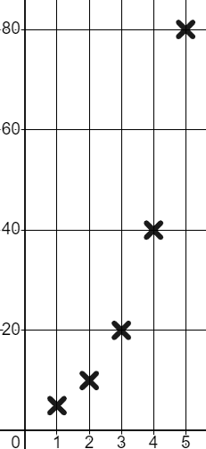
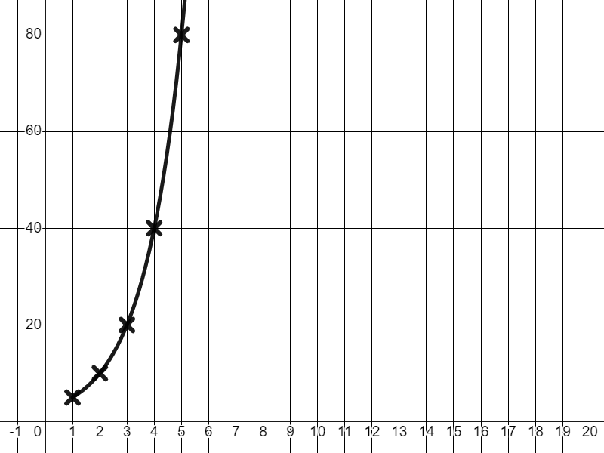
Graphing a common ratio greater than 1
We see the same curved shape when we graph other geometric sequences.
T
Term number (n) | 1 | 2 | 3 | 4 | 5
Term value (T) | 5 | 10 | 20 | 40 | 80
Term number (n) | 1 | 2 | 3 | 4 | 5
Term value (T) | 5
×2
×2
×2
×2
A line through these points enables us to see this curved shape of increasing gradient more clearly. However, we don’t usually draw the line when plotting sequences.
n

Slide 11
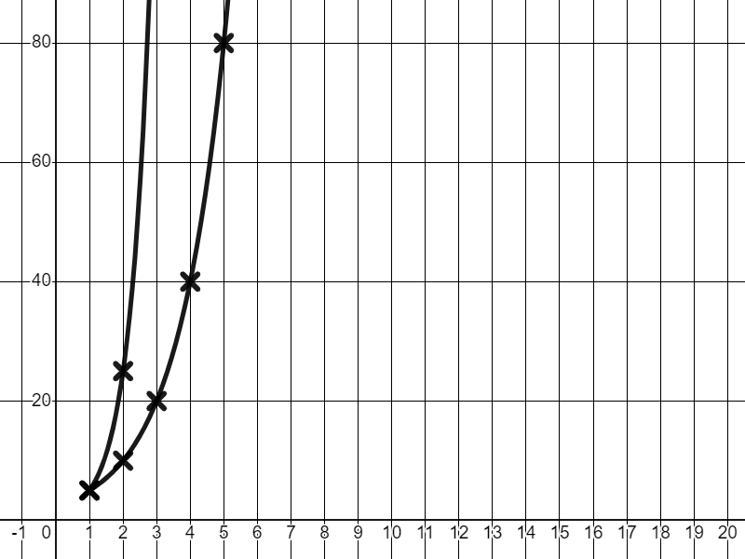
Graphing a common ratio greater than 1
Increasing the common ratio increases the speed of the rate of change.
T
×5
Term number (n) | 1 | 2 | 3 | 4 | 5
Term value (T) | 5 | 10 | 20 | 40 | 80
×2
×2
×2
×2
Term number (n) | 1 | 2 | 3 | 4 | 5
Term value (T) | 5
×2
Term number (n) | 1 | 2 | 3 | 4 | 5
Term value (T) | 5 | 25 | 125 | 625 | 3125
×5
×5
×5
×5
n

Slide 12
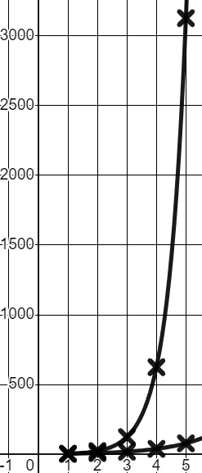
Graphing a common ratio greater than 1
Because the rate of change of ×5 is so fast, we need to adjust the axis scale.
T
×5
Term number (n) | 1 | 2 | 3 | 4 | 5
Term value (T) | 5 | 10 | 20 | 40 | 80
×2
×2
×2
×2
Term number (n) | 1 | 2 | 3 | 4 | 5
Term value (T) | 5
Term number (n) | 1 | 2 | 3 | 4 | 5
Term value (T) | 5 | 25 | 125 | 625 | 3125
×2
×5
×5
×5
×5
n

Slide 13
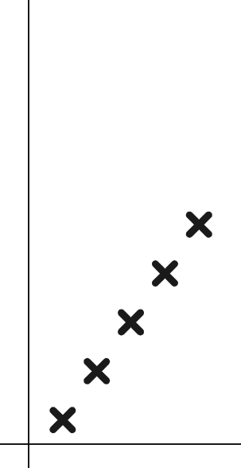
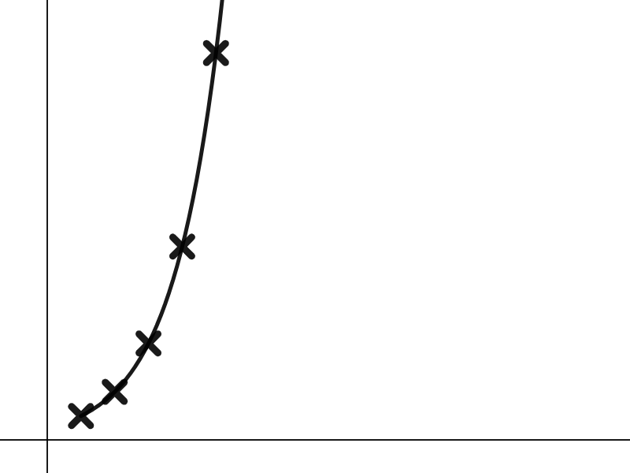
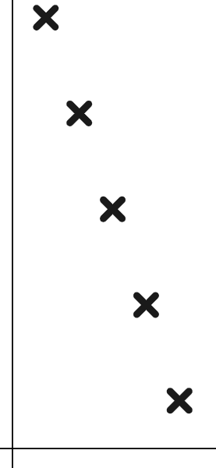
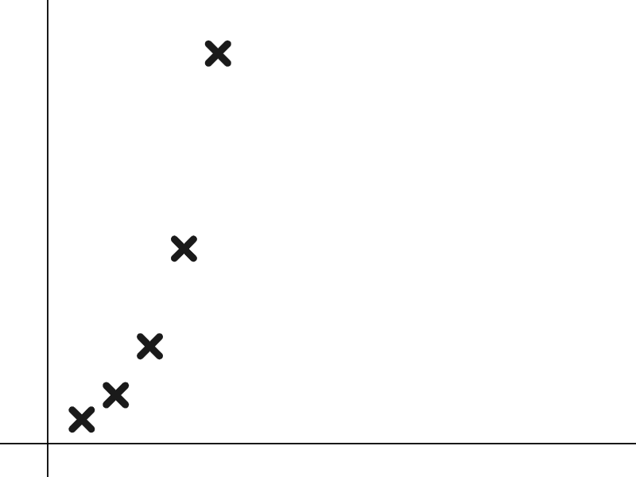


Graphing a common ratio greater than 1
Which of these graphs could show a geometric sequence?
The scales for T and n increase in equal amounts.
T
T
T
Arithmetic (linear) sequence
Arithmetic (linear) sequence
Geometric sequence
n
n
n

Slide 14
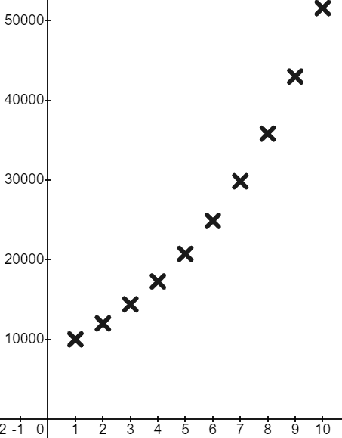
Graphing a common ratio greater than 1
This graph is a great example of where you will see this maths in the real world.
£
A business invests £10 000 in shares of a Green Energy company. Their value grows by 20% every year.
t | 1 | 2 | 3 | 4 | 5 | …
£ | 10 000 | 12 000 | 14 400 | 17 280 | 20 736
t | 1 | 2 | 3 | 4 | 5 | …
£ | 10 000
×1.2
×1.2
×1.2
×1.2
t
The longer they leave the investment, the faster it grows.

Slide 15

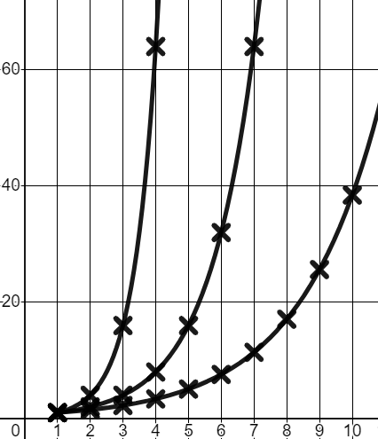
Graphing a common ratio greater than 1
Here are the graphs of three geometric sequences with lines drawn to show their upward curves.
T
c
a
Match these common ratios to their respective line.
b
a
Common ratio of 2
b
Common ratio of 1.5
c
Common ratio of 4
n

Slide 16
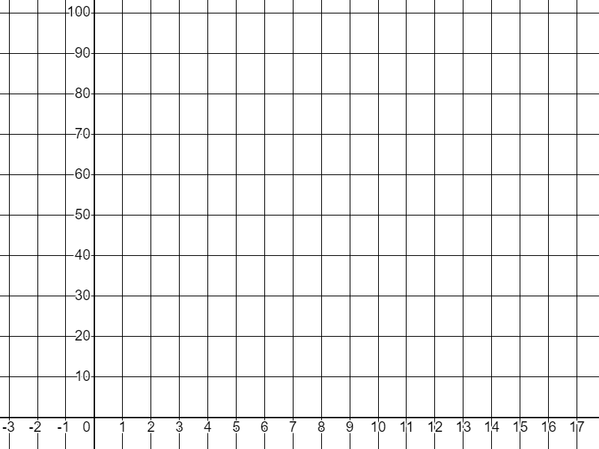
Graphing a common ratio greater than 1
1) Fill in the table of values and plot the geometric sequence that starts on 1 and has a common ratio of 3
T
Term number (n) | 1 | 2 | 3 | 4 | 5
Term value (T)
n

Slide 17
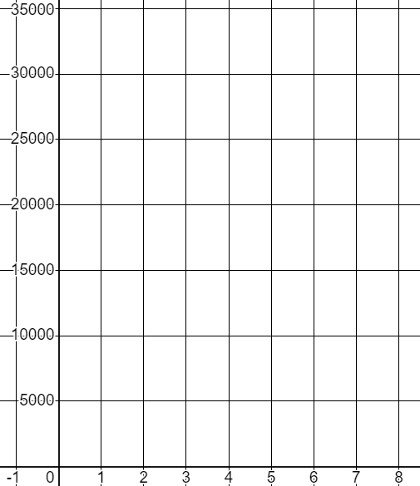
Graphing a common ratio greater than 1
2) You invest £2000 in a new tech company and your shares grow in value by 50% each year. Calculate their value for the first 8 years and plot it on the graph.
£
t | 1 | 2 | 3 | 4 | 5 | 6 | 7 | 8
£ | 2000
×1.5
Hint: To increase by 50% is a multiplier of 1.5
t
Hint: Round your values to the nearest £1 and plot approximately.

Slide 18
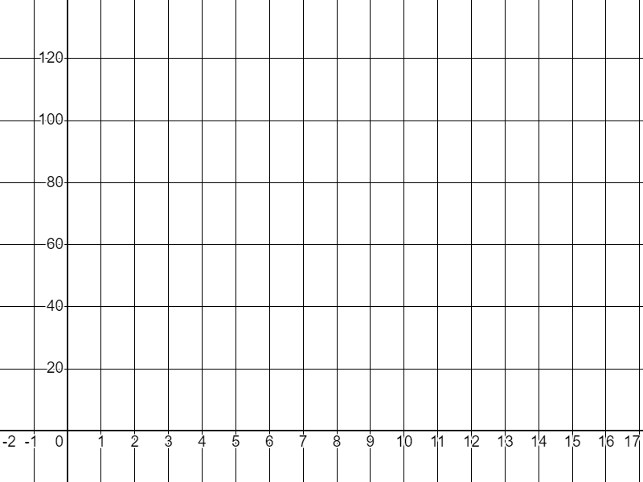
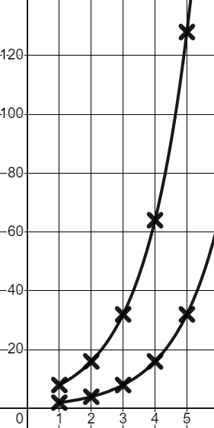
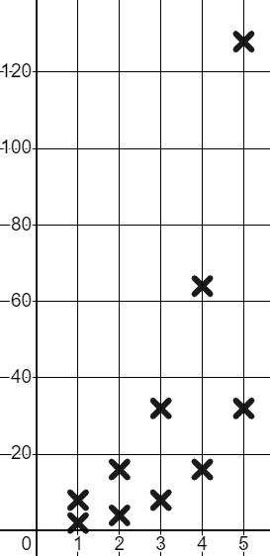
Graphing a common ratio greater than 1
3) Sam is contemplating the shape of the graphs of geometric sequences.
T
I don’t know if the starting term affects the shape. If I use the same common ratio of 2 but start on two different numbers will I get a different shape?
n | 1 | 2 | 3 | 4 | 5
T | 2
n | 1 | 2 | 3 | 4 | 5
T | 8
Using a common ratio of 2 to complete the tables, plot both graphs, and write a conclusion for Sam.
Beware, you can only plot the points approximately.
n

Slide 19
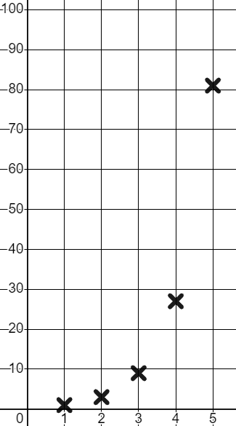
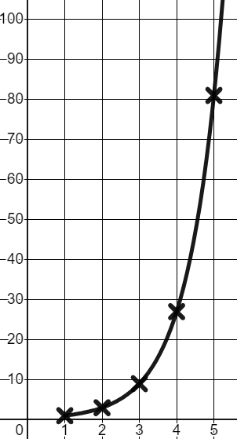
Graphing a common ratio greater than 1
1) Fill in the table of values and plot the geometric sequence that starts on 1 and has a common ratio of 3
T
Term number (n) | 1 | 2 | 3 | 4 | 5
Term value (T) | 1 | 3 | 9 | 27 | 81
Term number (n) | 1 | 2 | 3 | 4 | 5
Term value (T)
×3
×3
×3
×3
A line helps us to see the curve of a geometric sequence but, we don’t draw it.
n

Slide 20
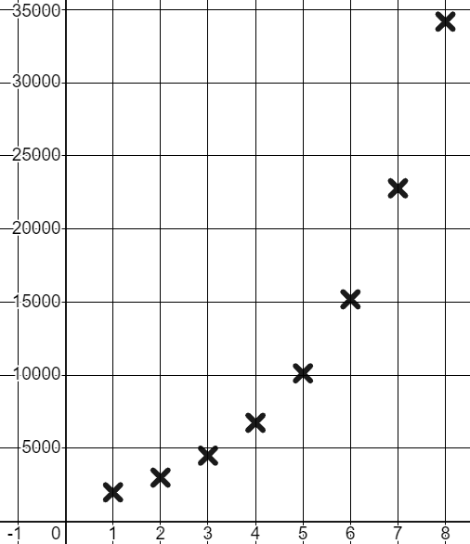
Graphing a common ratio greater than 1
2) You invest £2000 in a new tech company and your shares grow in value by 50% each year. Calculate their value for the first 8 years and plot it on the graph.
£
t | 1 | 2 | 3 | 4 | 5 | 6 | 7 | 8
£ | 2000
t | 1 | 2 | 3 | 4 | 5 | 6 | 7 | 8
£ | 2000 | 3000 | 4500 | 6750 | 10 125 | 15 188 | 22 781 | 34 172
×1.5
×1.5
×1.5
×1.5
×1.5
×1.5
×1.5
t
The points plot the curved pattern of a geometric sequence.

Slide 21
Graphing a common ratio greater than 1
3) Sam is contemplating the shape of the graphs of geometric sequences.
T
I don’t know if the starting term affects the shape. If I use the same common ratio of 2 but start on two different numbers will I get a different shape?
n | 1 | 2 | 3 | 4 | 5
T | 2 | 4 | 8 | 16 | 32
n | 1 | 2 | 3 | 4 | 5
T | 2
n | 1 | 2 | 3 | 4 | 5
T | 8 | 16 | 32 | 64 | 128
n | 1 | 2 | 3 | 4 | 5
T
×2
×2
×2
×2
×2
×2
×2
×2
Using a common ratio to complete the tables, plot both graphs, and write a conclusion for Sam.
n

Slide 22
Graphing a common ratio greater than 1
3) Sam is contemplating the shape of the graphs of geometric sequences.
T
I don’t know if the starting term affects the shape. If I use the same common ratio of 2 but start on two different numbers will I get a different shape?
n | 1 | 2 | 3 | 4 | 5
T | 2 | 4 | 8 | 16 | 32
n | 1 | 2 | 3 | 4 | 5
T | 2
n | 1 | 2 | 3 | 4 | 5
T | 8 | 16 | 32 | 64 | 128
n | 1 | 2 | 3 | 4 | 5
T
×2
×2
×2
×2
×2
×2
×2
×2
Both graphs have the same shape.
An upward curve getting increasingly more steep.
n

Slide 23
Representing geometric sequences graphically
Graphing a common ratio greater than 1
Graphing a common ratio less than 1

Slide 24

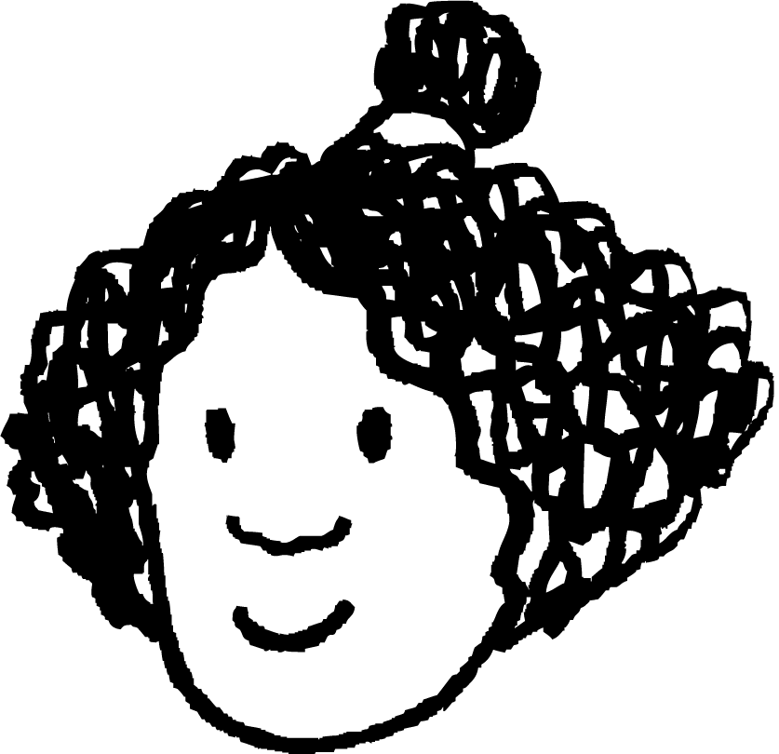
Graphing a common ratio less than 1
Izzy and Jacob are plotting geometric graphs.
n | 1 | 2 | 3 | 4 | 5 | …
T | 10 000 | 12 000 | 14 400 | 17 280 | 20 736
T
×1.2
×1.2
×1.2
×1.2
Geometric graphs are so pretty!
They always make an upward curve, no matter how small the common ratio!
Are you sure Jacob? Have you tried a common ratio of 1?
n

Slide 25
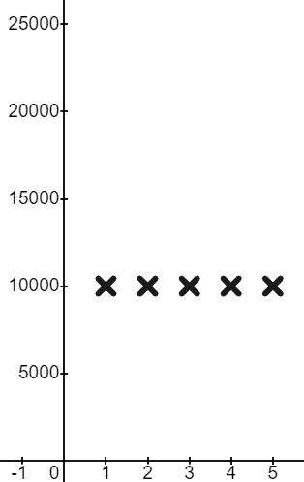
Graphing a common ratio less than 1
Izzy and Jacob are plotting geometric graphs.
n | 1 | 2 | 3 | 4 | 5 | …
T | 10 000 | 10 000 | 10 000 | 10 000 | 10 000
T
n | 1 | 2 | 3 | 4 | 5 | …
T | 10 000
×1
×1
×1
×1
Of course! The ratio is always 1 : 1
The value never changes!
Yes. You get a straight horizontal line from your first value.
n

Slide 26

Graphing a common ratio less than 1
Common ratio 2
Common ratio 1
T
So what shape would a common ratio of give us?
T
I don’t know. Let’s find out!
n
n

Slide 27
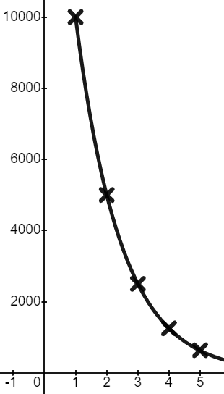
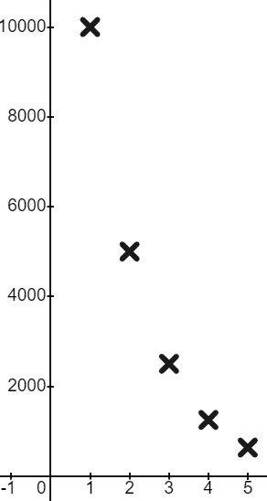

Graphing a common ratio less than 1
Common ratio of
T
n | 1 | 2 | 3 | 4 | 5
T | 10 000 | 5 000 | 2 500 | 1 250 | 625
n | 1 | 2 | 3 | 4 | 5
T | 10 000
Of course! The values decrease!
It still makes a curve but it’s a downward curve.
n

Slide 28
Graphing a common ratio less than 1
Common ratio of
T
n | 1 | 2 | 3 | 4 | 5
T | 10 000 | 5 000 | 2 500 | 1 250 | 625
n | 1 | 2 | 3 | 4 | 5
T | 10 000
The line shows us the nature of the curve. Decreasing but at a rate which is slowing.
However, we don’t draw the line for this sequence. There is no 1.5th term.
n

Slide 29

Graphing a common ratio less than 1
Common ratio of
T
n | 1 | 2 | 3 | 4 | 5
T | 10 000 | 5 000 | 2 500 | 1 250 | 625
n | 1 | 2 | 3 | 4 | 5
T | 10 000
So will we get this shape for all ratios less than 1?
I don’t know. Let’s try
n

Slide 30
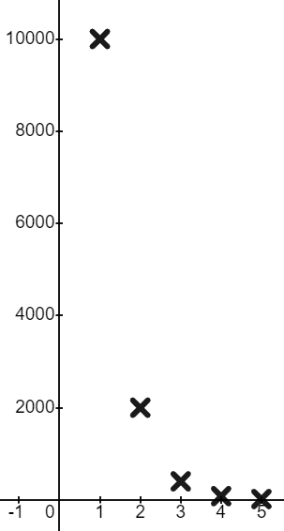
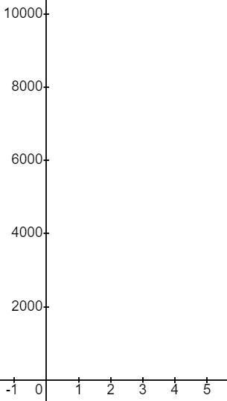
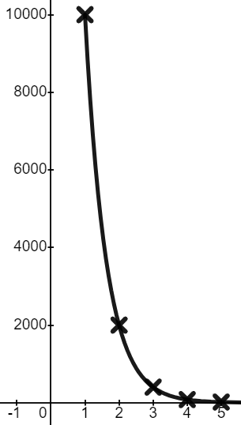

Graphing a common ratio less than 1
Common ratio of
T
n | 1 | 2 | 3 | 4 | 5
T | 10 000 | 2000 | 400 | 80 | 16
n | 1 | 2 | 3 | 4 | 5
T | 10 000
It’s the same shape. Just a much steeper curve!
What an interesting graph!
n

Slide 31

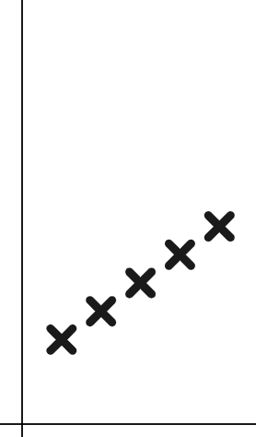
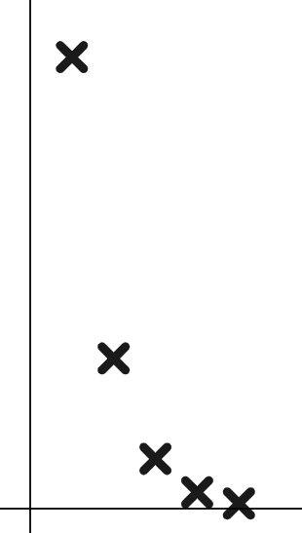
Graphing a common ratio less than 1
Which of these graphs shows a geometric sequence with common ratio ?
(The scales for T and n increase in equal amounts.)
T
T
T
Geometric sequence common ratio >1
Arithmetic (linear) sequence
Geometric sequence common ratio
n
n
n

Slide 32
Graphing a common ratio less than 1
Common ratio of
T
n | 1 | 2 | 3 | 4 | 5
T | 10 000 | 2000 | 400 | 80 | 16
n | 1 | 2 | 3 | 4 | 5
T | 10 000
Wait! We didn’t test all types of common ratios less than 1
What do you think Jacob could be referring to?
n

Slide 33
Graphing a common ratio less than 1
Common ratio of
T
n | 1 | 2 | 3 | 4 | 5
T | 10 000 | 2000 | 400 | 80 | 16
n | 1 | 2 | 3 | 4 | 5
T | 10 000
Wait! We didn’t test all types of common ratios less than 1
Do you mean negatives?
n

Slide 34
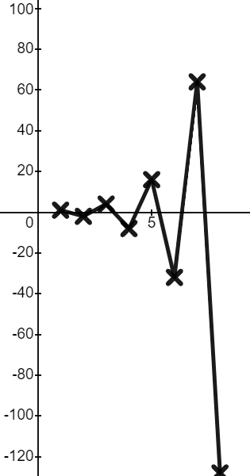
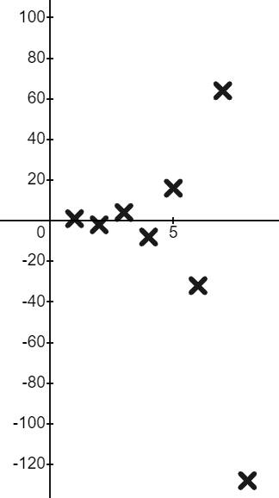
Graphing a common ratio less than 1
Common ratio of −2
T
n | 1 | 2 | 3 | 4 | 5 | 6 | 7 | 8
T | 1
n | 1 | 2 | 3 | 4 | 5 | 6 | 7 | 8
T | 1 | −2 | 4 | −8 | 16 | −32 | 64 | −128
×−2
×−2
×−2
×−2
×−2
×−2
×−2
n
What a strange graph!
It’s oscillating between positive and negative terms.

Slide 35
Graphing a common ratio less than 1
Common ratio of −2
T
n | 1 | 2 | 3 | 4 | 5 | 6 | 7 | 8
T | 1
n | 1 | 2 | 3 | 4 | 5 | 6 | 7 | 8
T | 1 | −2 | 4 | −8 | 16 | −32 | 64 | −128
×−2
×−2
×−2
×−2
×−2
×−2
×−2
n
When the common ratio of a geometric sequence is negative the terms oscillate from positive to negative.

Slide 36
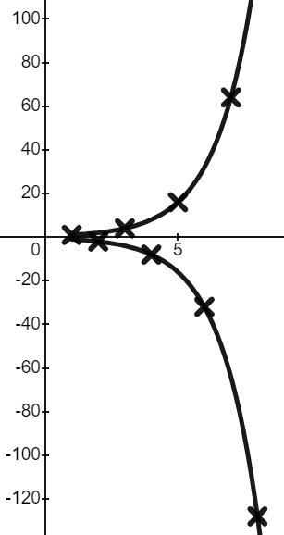
Graphing a common ratio less than 1
Common ratio of −2
T
n | 1 | 2 | 3 | 4 | 5 | 6 | 7 | 8
T | 1
n | 1 | 2 | 3 | 4 | 5 | 6 | 7 | 8
T | 1 | −2 | 4 | −8 | 16 | −32 | 64 | −128
×−2
×−2
×−2
×−2
×−2
×−2
×−2
n
You might notice that the positive terms still form a curve, and the negative terms form their own curve.

Slide 37
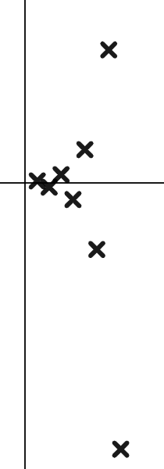
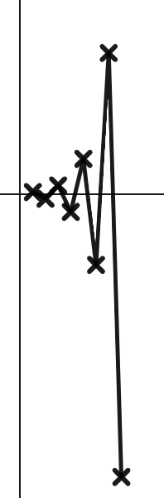
Graphing a common ratio less than 1
This is the graph of a geometric sequence. What could the common ratio be?
T
5
n
When the terms oscillate from positive to negative the common ratio must be negative.
−5

Slide 38
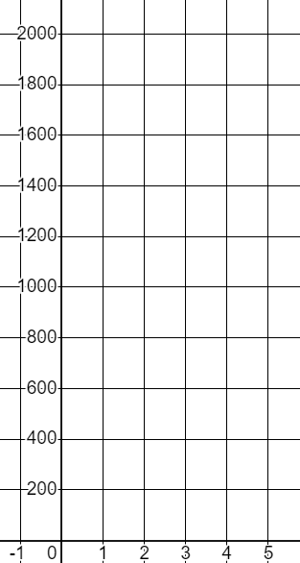

Graphing a common ratio less than 1
1) a) Complete the table of values and graph this geometric sequence with a common ratio
T
n | 1 | 2 | 3 | 4 | 5
T | 2025
Plot the coordinates as accurately as you can.
n

Slide 39


Graphing a common ratio less than 1
1) b) Complete the table of values and graph this geometric sequence with a common ratio
T
n | 1 | 2 | 3 | 4 | 5
T | 2025
Plot the coordinates as accurately as you can.
n

Slide 40
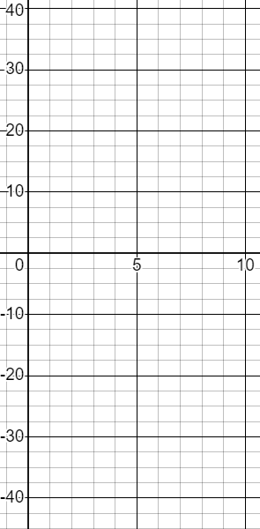
Graphing a common ratio less than 1
2) Complete the table of values and graph this geometric sequence with a common ratio −1.5
T
n | 1 | 2 | 3 | 4 | 5 | 6 | 7 | 8
T | 2.56
n
×−1.5
Plot the coordinates as accurately as you can.

Slide 41
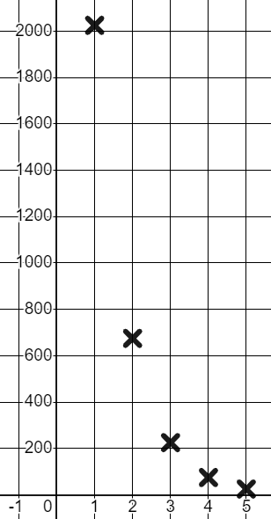
Graphing a common ratio less than 1
1) a) Complete the table of values and graph this geometric sequence with a common ratio
T
n | 1 | 2 | 3 | 4 | 5
T | 2025 | 675 | 225 | 75 | 25
n | 1 | 2 | 3 | 4 | 5
T | 2025
Common ratio between 0 and 1 giving us a downward curve.
n

Slide 42
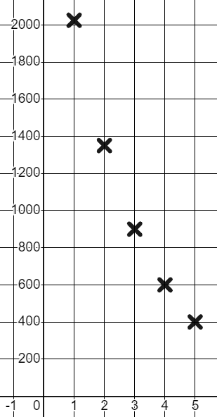
Graphing a common ratio less than 1
1) b) Complete the table of values and graph this geometric sequence with a common ratio
T
n | 1 | 2 | 3 | 4 | 5
T | 2025 | 1350 | 900 | 600 | 400
n | 1 | 2 | 3 | 4 | 5
T | 2025
Common ratio between 0 and 1 giving us a downward curve slightly less steep than our curve.
n

Slide 43
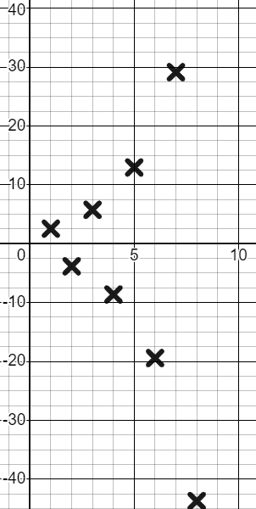
Graphing a common ratio less than 1
2) Complete the table of values and graph this geometric sequence with a common ratio −1.5
T
n | 1 | 2 | 3 | 4 | 5 | 6 | 7 | 8
T | 2.56 | −3.84 | 5.76 | −8.64 | 12.96 | −19.44 | 29.16 | −43.74
n | 1 | 2 | 3 | 4 | 5 | 6 | 7 | 8
T | 2.56
n
×−1.5
×−1.5
×−1.5
×−1.5
×−1.5
×−1.5
×−1.5
Negative common ratio giving us oscillating terms with the positive ones forming a curve and the negative ones forming a curve.

Slide 44
Representing geometric sequences graphically
We can represent geometric sequences graphically and appreciate that some of them form an upward curve, some form a downward curve, and some oscillate from positive to negative.

Slide 45

© Oak National Academy 2024.
Produced in partnership with Mathematics in Education and Industry.
Licensed on the Open Government Licence v3.0, except where otherwise stated. See Oak terms and conditions.

